Slide 1
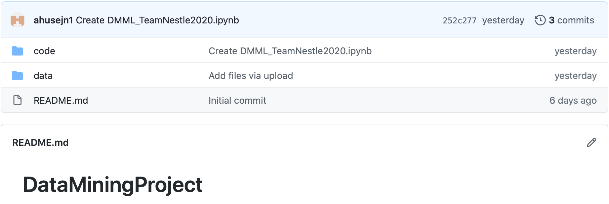
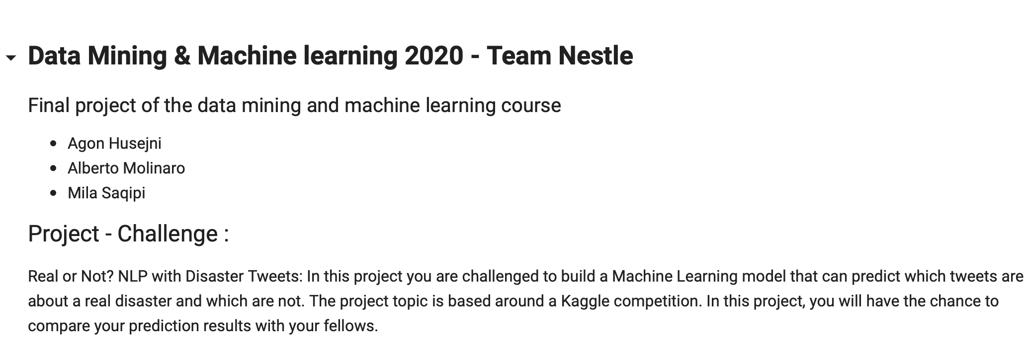
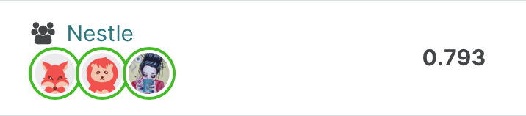
DATA MINING AND MACHINE LEARNING
SUMMARY OF THE WEEK
Final project
Task performed
TEAM ORGANIZATION
GITHUB STRUCTURE
EDA - EXPLORATION OF THE DATA
FIRST TRY - FIRST SUBMISSION
TEAM NESTLE
Agon Husejni, Alberto Molinaro, Mila Saqipi

